Slide 1
Artificial Intelligence
Search Algorithms
Notes:
Slides and exercises are inspired by Russell & Norvig AI Book, Stanford’s AI course and from Berkeley’s AI course

Slide 2
Definition of a problem
Initial state
Actions(s) → {a1, a2, a3, ..}
Result(s,a) → s’
goalTest(s) → T|F
pathCost(s1→a1→s2→a2→s3..) →n
PathCost is additive based on a stepCost function
StepCost( s1→a1→s2) → n

Slide 3
Search strategies
Uninformed
Informed
Breadth first search
Uniform cost search
Depth first search
Greedy best-first search
A* Search

Slide 4
Examples of search problems
Traveling in Romania
The vacuum world
The 8-puzzle
The 8-queens
Knuth’s infinite search space
Rubic’s cube
…

Slide 5
Find a route from Arad to Bucharest
State space:
Cities
Transition model:
Go to adjacent city with cost = distance
Start state:
Arad
Goal test:
Is state == Bucharest?
Solution?

Slide 6
The vacuum world
Number of states: 2² . 2 = 8

Slide 7
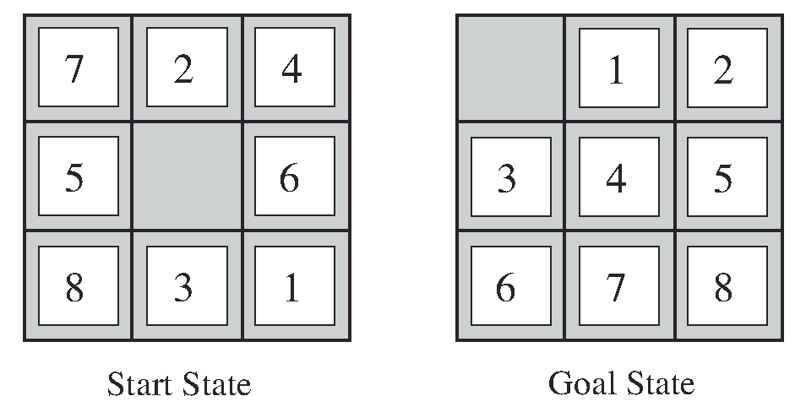
The 8-puzzle
Number of states: 9!/2

Slide 8

The 8 queens problem
Complete-state formulation: 64*63*…=1.8*10¹⁴
Incremental (each action adds a queen): 2,057

Slide 9
Infinite state space

Slide 10
Real world problems
Routing
Touring
TSP (Travel Salesperson Problem)
VLSI Layout
Robot navigation
Automatic Assembly sequencing
…
Notes:
What is the difference between touring and TSP
Touring: visit each city at least once
TSP: visit each city exactly once

Slide 11
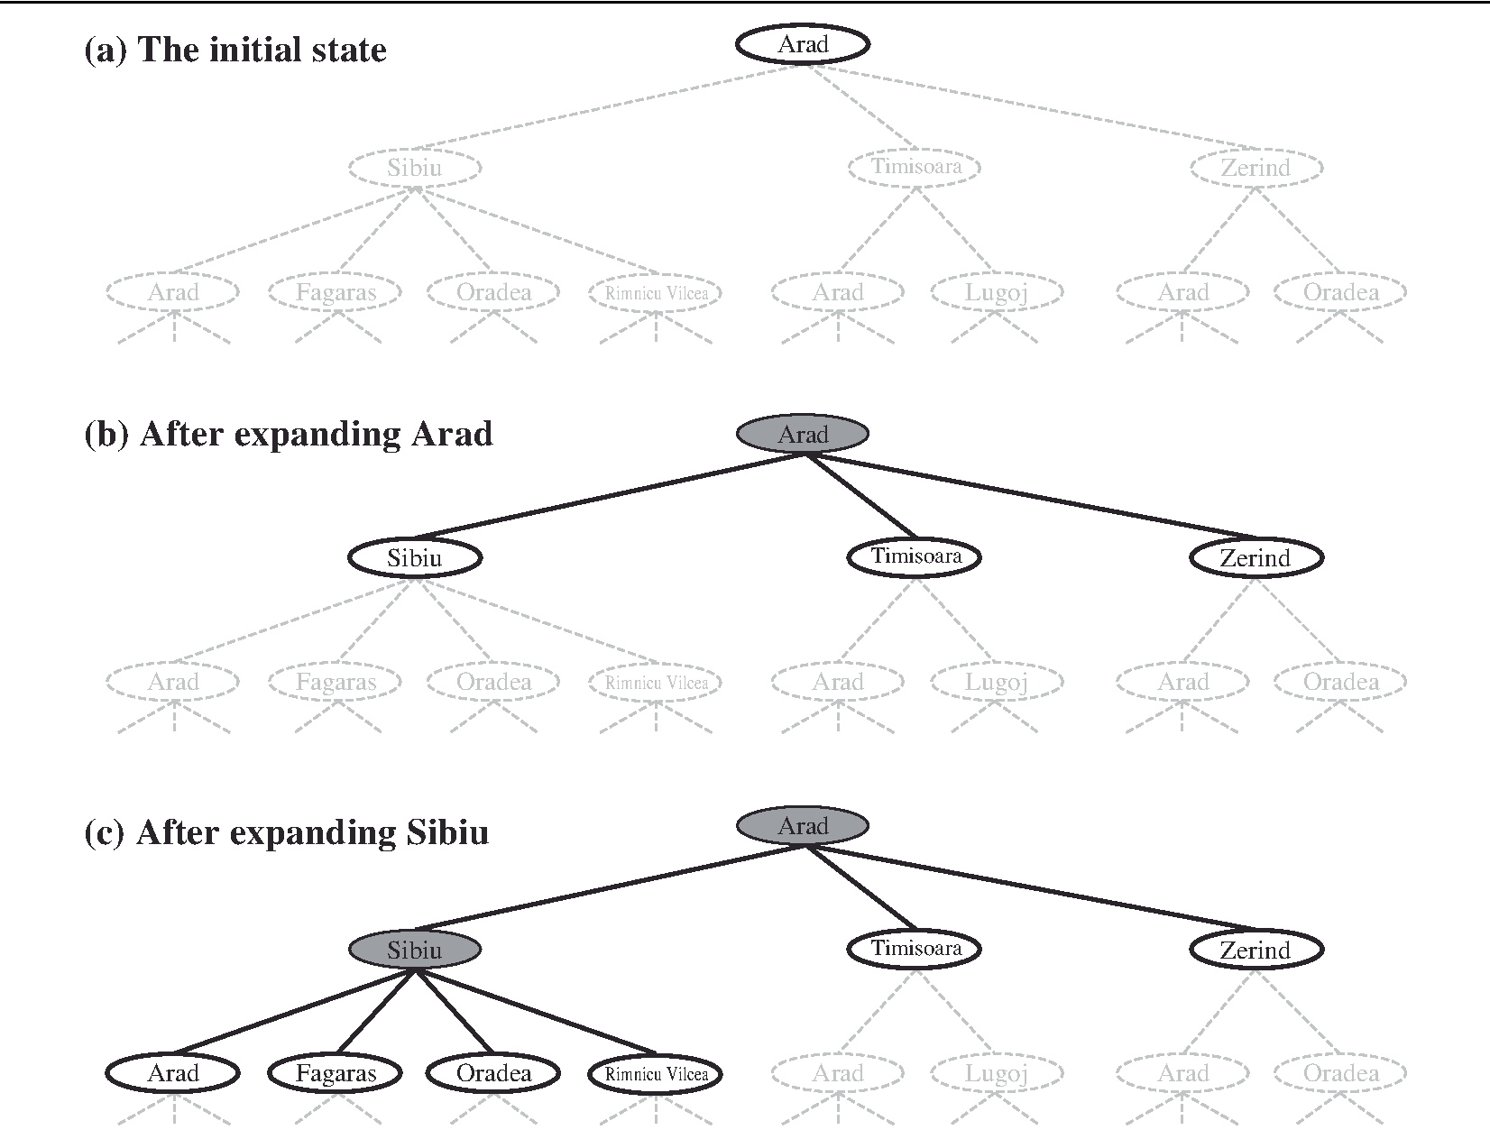
Search tree
A search tree:
A “what if” tree of plans and their outcomes
The start state is the root node
Children correspond to successors

Slide 12
Search tree vs. state graph

Slide 13
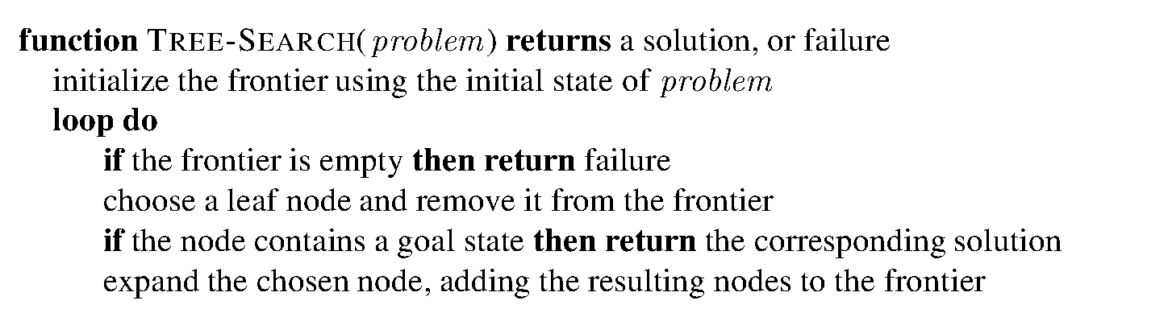
General tree search algorithm

Slide 14
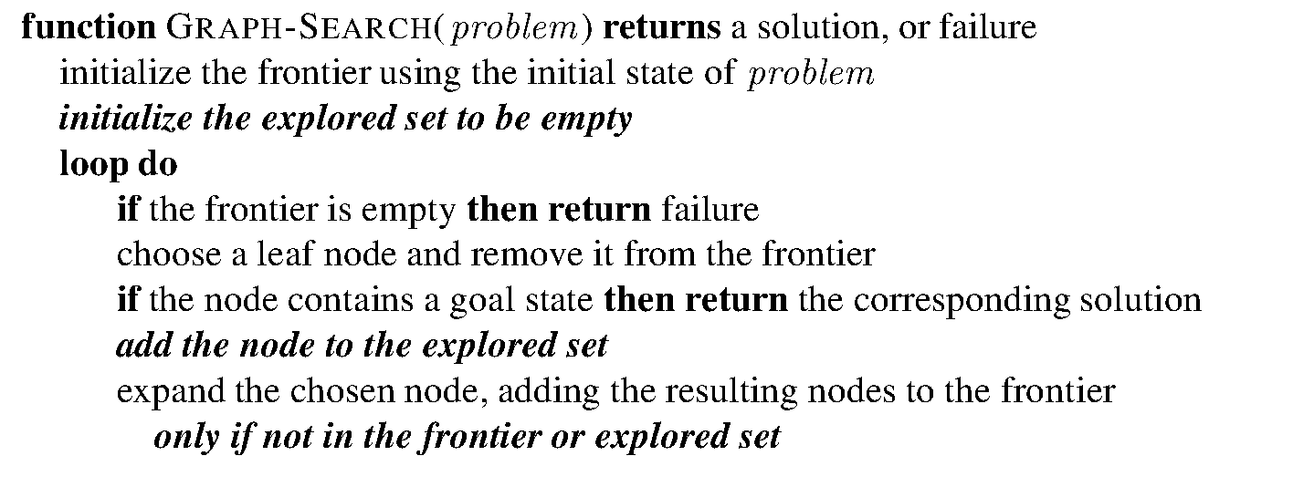
General graph search algorithm
Notes:
Frontier set is sometimes called fringe
Explored set is sometimes called closed set

Slide 15
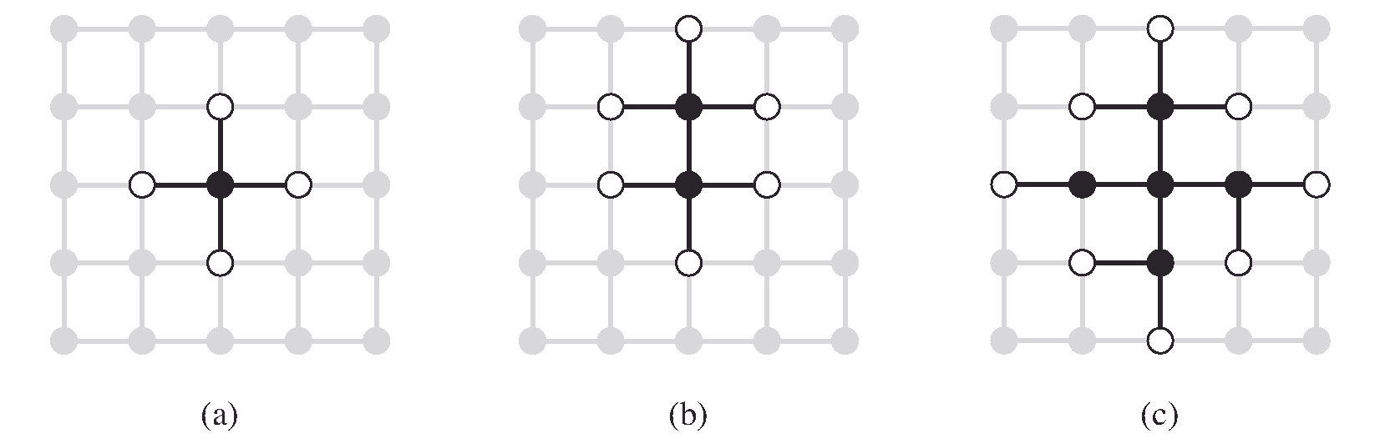
Separation property of the graph search
The frontier (white nodes) always separates the explored region of the state space (black nodes) from the unexplored region (gray nodes).

Slide 16
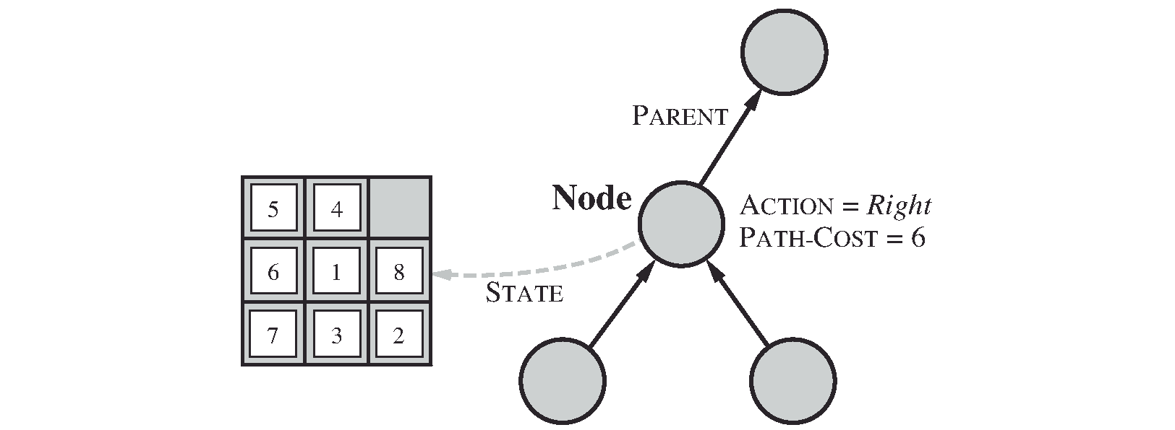
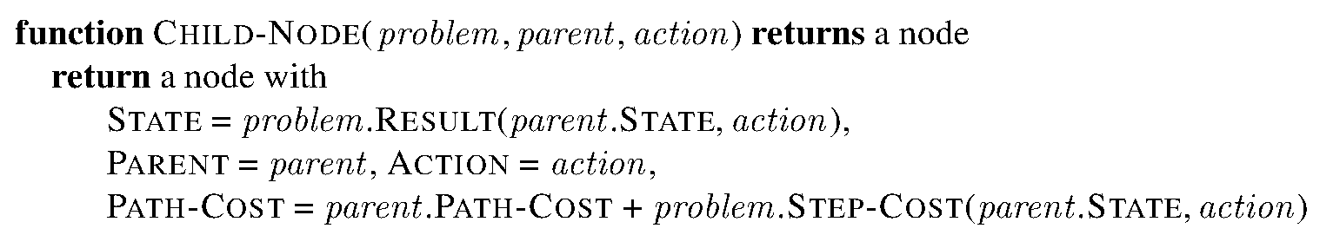
Node as a data structure to support space representation
Node != State
Nodes are the data structures from which the search tree is constructed.
Parent / Action
bookkeeping
Path-cost
State

Slide 17
Implementation
Search strategy: which next node to explore?
Explored set can be implemented as a hash table for efficient checking
Queue data structures are useful for keeping the frontier nodes:
FIFO
LIFO (Stack)
Priority queue
Possible operations on a queue:
Insert / push
Pop
isEmpty?

Slide 18
Measuring problem solving performance
Completeness
Is the algorithm guaranteed to find a solution when there is one?
Optimality
Does the strategy find the optimal solution
Time complexity
How long does it take to find a solution?
Measured by number of expanded nodes
Space complexity
How much memory is needed to perform the search?
Parameters
b is the branching factor
m is the maximum depth
d is the depth of the shallowest goal node

Slide 19
Search strategies – Breadth First Search (BFS)
Expand the shallowest node first
Let depth of shallowest solution be d
Search takes time O(b^{d})
Space needed has roughly the last tier, so O(b^{d})
Is it complete?
Yes, if a solution exists at a finite depth
Is it optimal?
Only if costs are all 1
b^{d} nodes

Slide 20
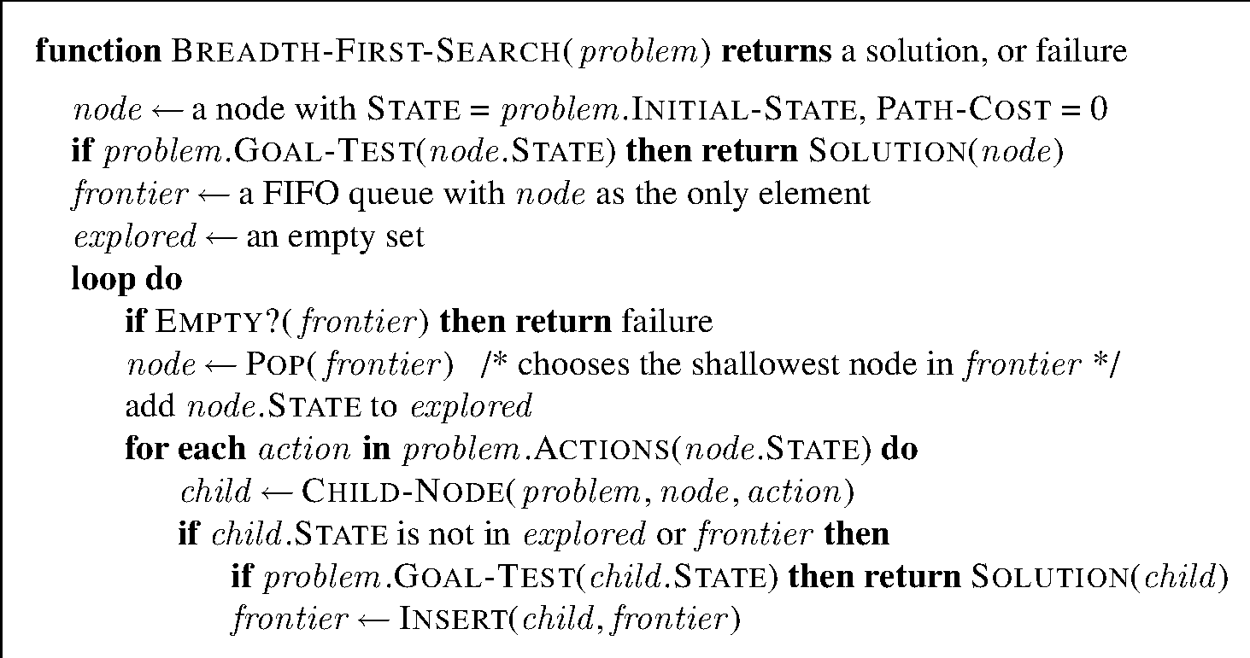
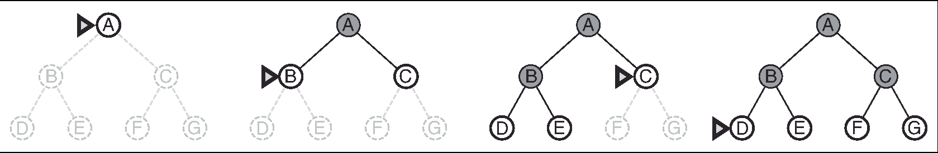
Example BFS graph search

Slide 21
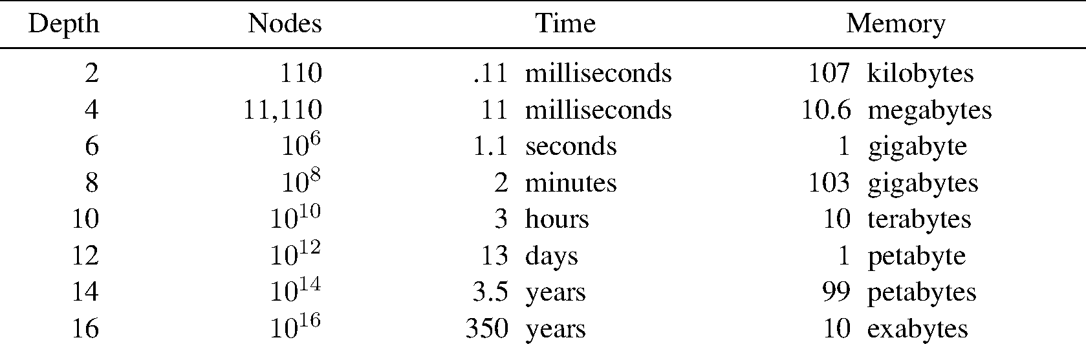
Time and memory requirements (b=10, 1 million nodes per second, 1000 bytes per node)
Total number of nodes generated:

Slide 22
Exercise

Slide 23
Uniform cost search
Expand the cheapest node first (priority queue)
Processes all nodes with cost less than cheapest solution!
Test when expanded, not when generated
If that solution costs C* and arcs cost at least ε , then the “effective depth” is roughly C*/ε
Takes time O(b^{C*/ε}) (exponential in effective depth)
O(b^{C*/ε}) space is needed for the frontier tier
Is it complete?
Assuming best solution has a finite cost and minimum arc cost is positive, yes!
Is it optimal?
Yes!

Slide 24
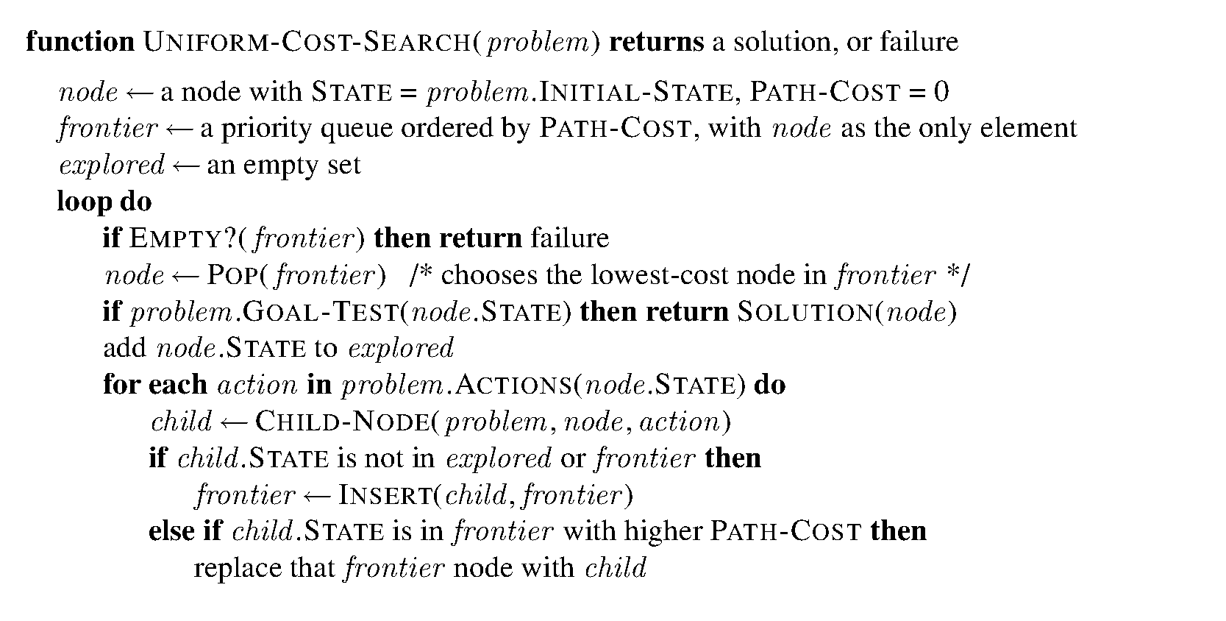
UCS pseudo-code
Problem:
Explores options in every “direction”

Slide 25
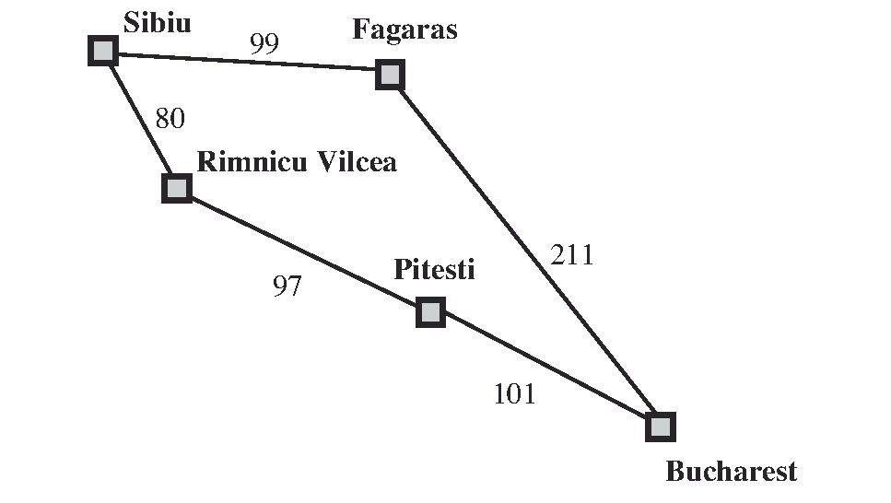
Exercise

Slide 26
Depth first search – DFS (Tree search)
Expands a deepest node first (Stack – LIFO)
If m is finite, takes time O(b^{m})
How much space does the frontier take?
Only has siblings on path to root, so O(bm)
Is it complete?
m could be infinite, so yes if no cycles
Is it optimal?
No, it finds the “leftmost” solution,
regardless of depth or cost

Slide 27
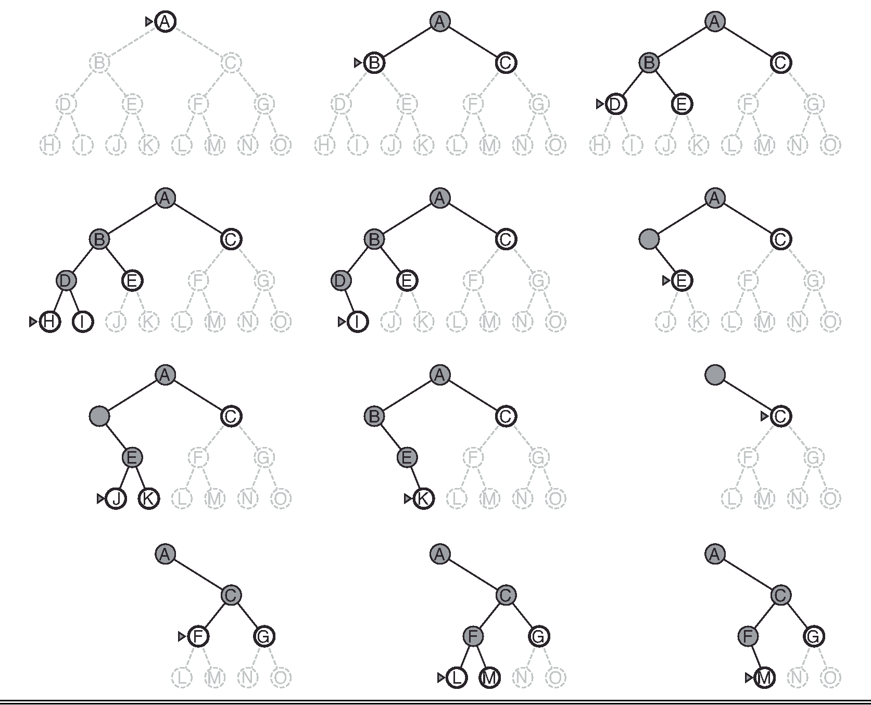
Depth first search – DFS

Slide 28
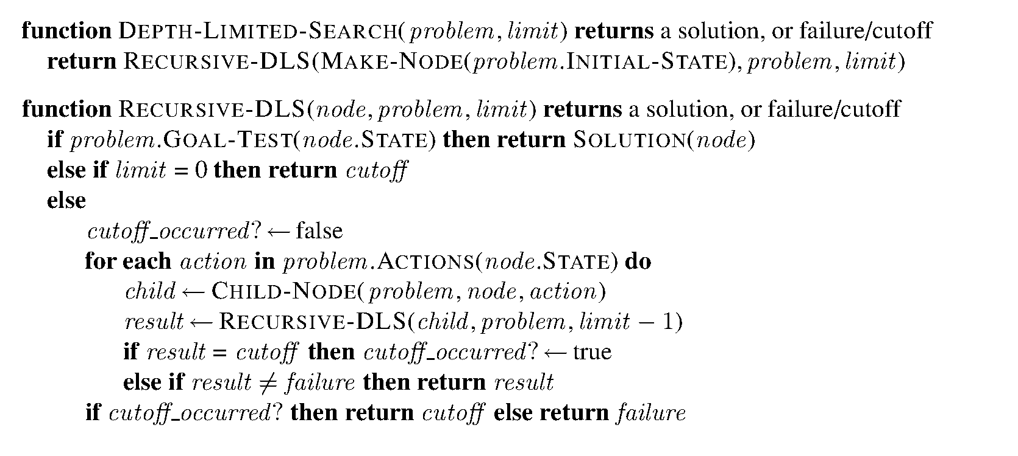
Depth limited search (recursive)
Example limit = 2
Failure
G
Cut-off
Solution

Slide 29
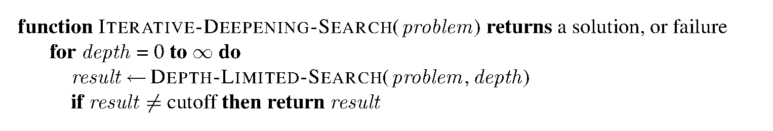
Iterative deepening depth first search
Idea: get DFS’s space advantage with BFS’s time / shallow-solution advantages
Run a DFS with depth limit 1. If no solution…
Run a DFS with depth limit 2. If no solution…
Run a DFS with depth limit 3. …..
Isn’t that wastefully redundant?
Generally, most work happens in the lowest level searched, so not so bad!

Slide 30
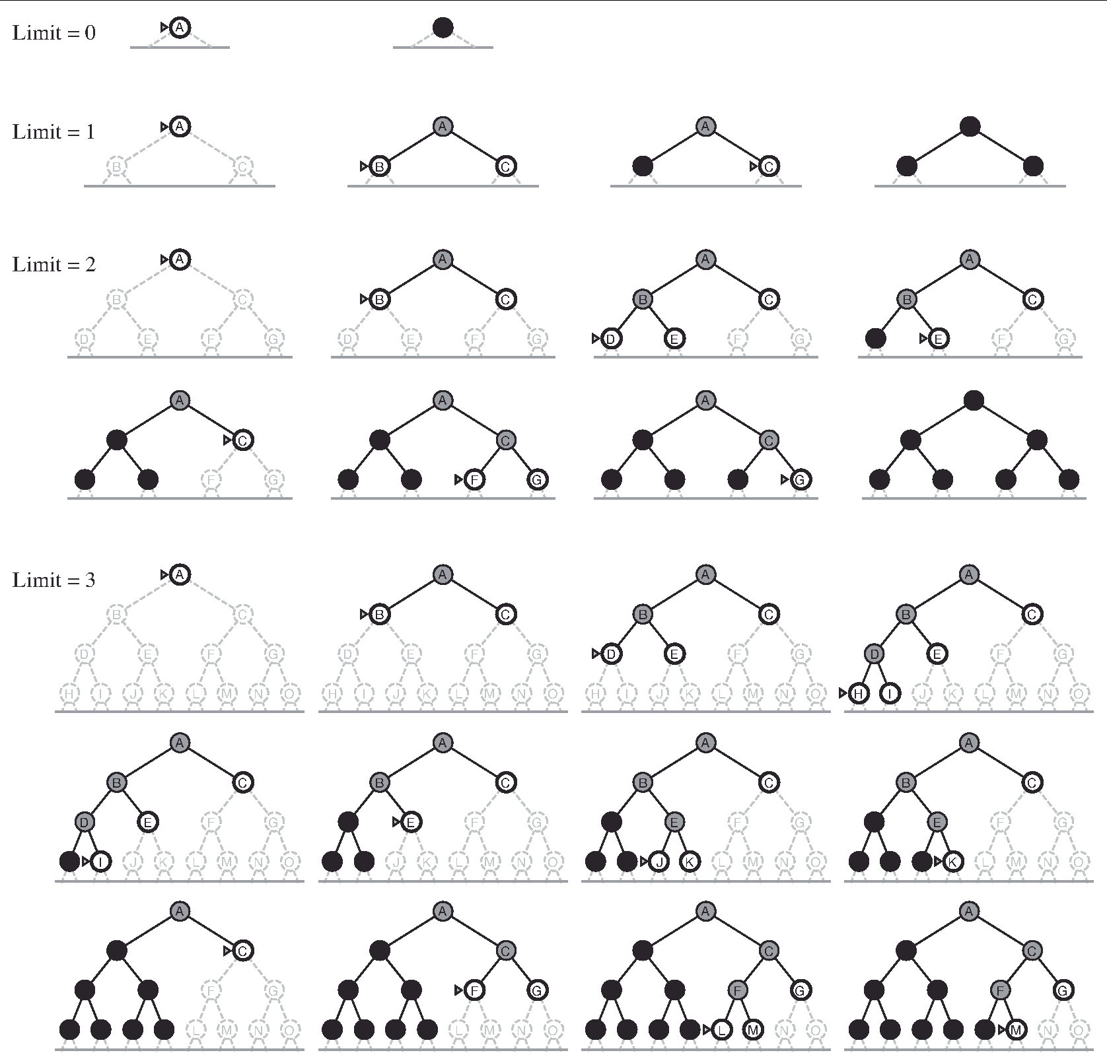
Iterative deepening search example

Slide 31
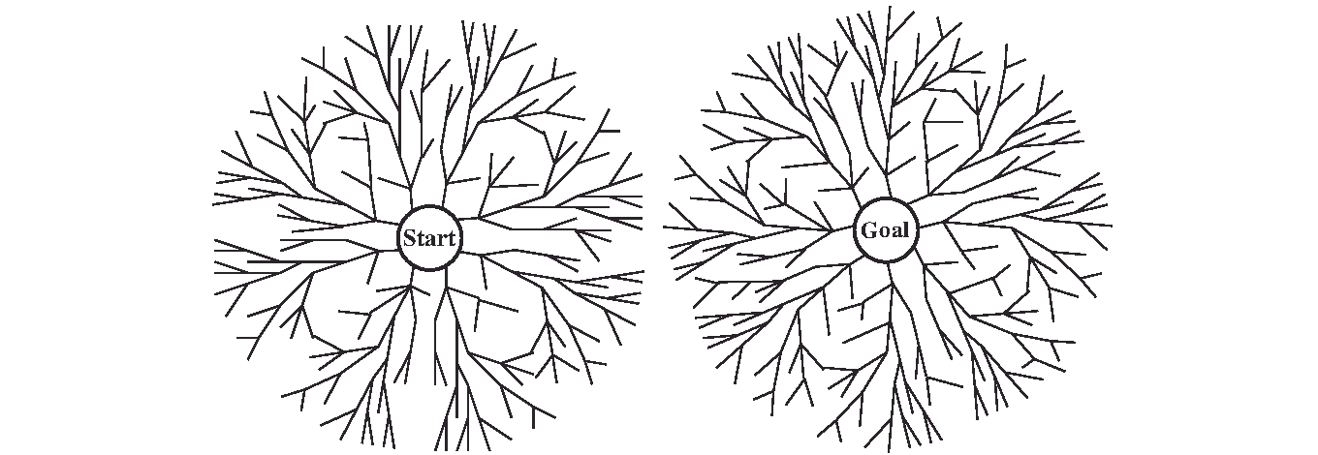
Bi-directional search
Problem:
If the goal is an abstract description, such as the goal that “no queen attacks another queen” in the n-queens problem, then bidirectional search is difficult to use.

Slide 32
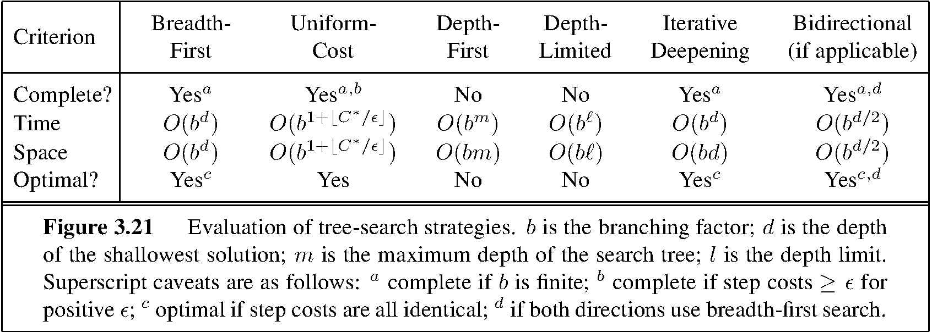
Comparing uninformed search strategies

